Slide 1

VTP
Anudeep Potlapally
Travis Rous

Slide 2
Client/Company
Nick Newell
EchoStar

Slide 3
Project
Web-based application
Video Sharing/Social Networking

Slide 4
Passed Sprints
Sprint 1:
Very Simple prototype
Sprint 2:
Research and contact Google
Database Design
Integration of Popcorn.js
Creating a Favorites page
Login via Google and Facebook
Error log

Slide 5
Current Sprint
Sprint 3
Adding image tags to database for video
Continued work on favorites page
Uses database to get information to populate based on the current user.
Still waiting on Google

Slide 6
Website Map

Slide 7
Current Prototype

Slide 8
Goals Met
Play YouTube
Login
Add Image Tags
Favorites
Database

Slide 9
Issues & Problems
Searching and Storing videos in YouTube
Waiting on YouTube Data API Approval.
Accessing friends lists of Google Users.
Privacy issues on Tag information

Slide 10
Remaining Backlog
Just some of the major ones…
Play videos from Vimeo
Implement other Tags
Filtering the Tags
Finalizing the Database
GUI Design

Slide 11
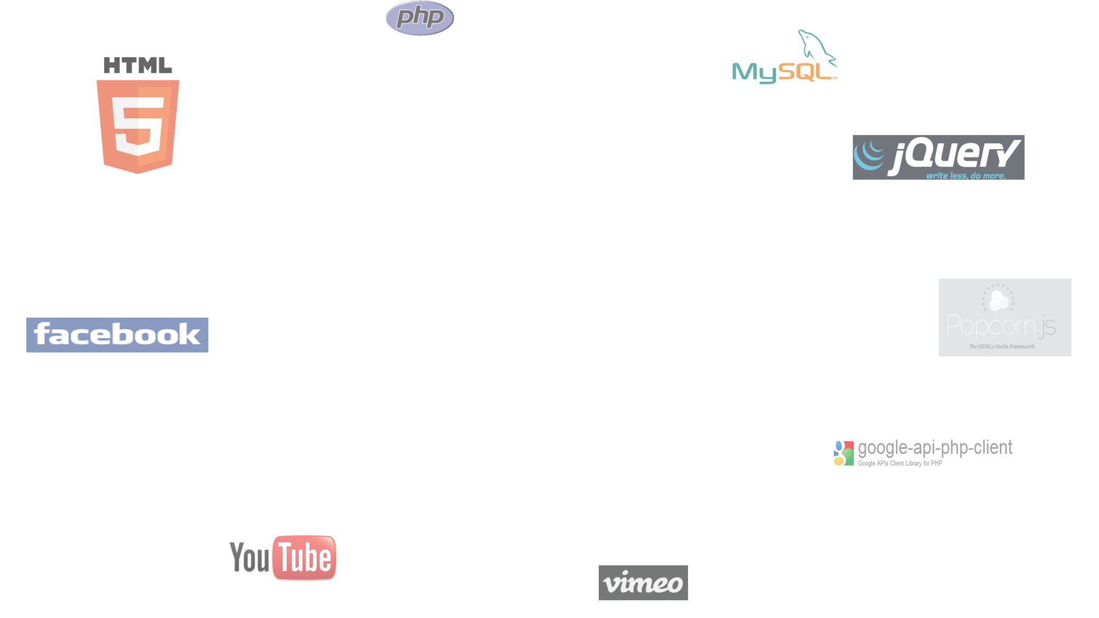
Questions?

